Slide 1
Existing Initiatives Aimed at Combating Representation Disparities in Computer Science
Minorities in Computer Science
CPSC-298-06
Interterm 2021
Instructor: Elia Eiroa Lledo

Slide 2
Some Existing Initiatives Targeting Minorities in Computer Science
So far, we have seen:
Minority groups have been essential in the development of technology and computer science
Today, there are huge disparities in the computer science world: women and racial and ethnic minorities are not proportionally involved in the tech world
These disparities are not caused by lack of interest but rather unequal access to tech and resources and other causes
Now we will focus on solutions:
Today we will look at existing initiatives & hopefully, these will inspire you for your final projects
You will start working on a proposal for your own initiative as a group

Slide 3
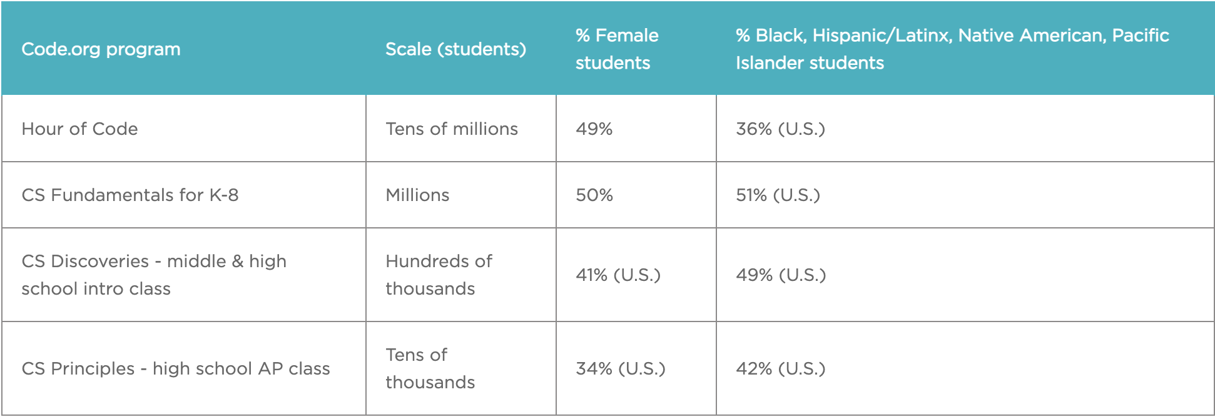
Code.org

Slide 4
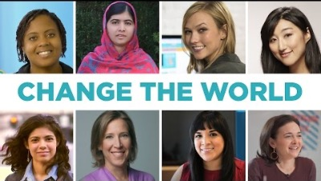
Code.org: The Hour of Code % Marketing
“By casting a wide range of lecturers, diverse CS role models from different industries are baked into our curriculum materials.”

Slide 5
Code.org: Other Initiatives
Professional Learning Program
Enables new educators to teach CS and helps schools establish new CS classrooms
CS Principles course
More students from underrepresented racial and ethnic groups enrolled in Code.org CS Principles classrooms today than the number of all AP Computer Science exam takers in 2016
Code.org Advocacy Coalition
Changed policies in all 50 U.S. states

Slide 6
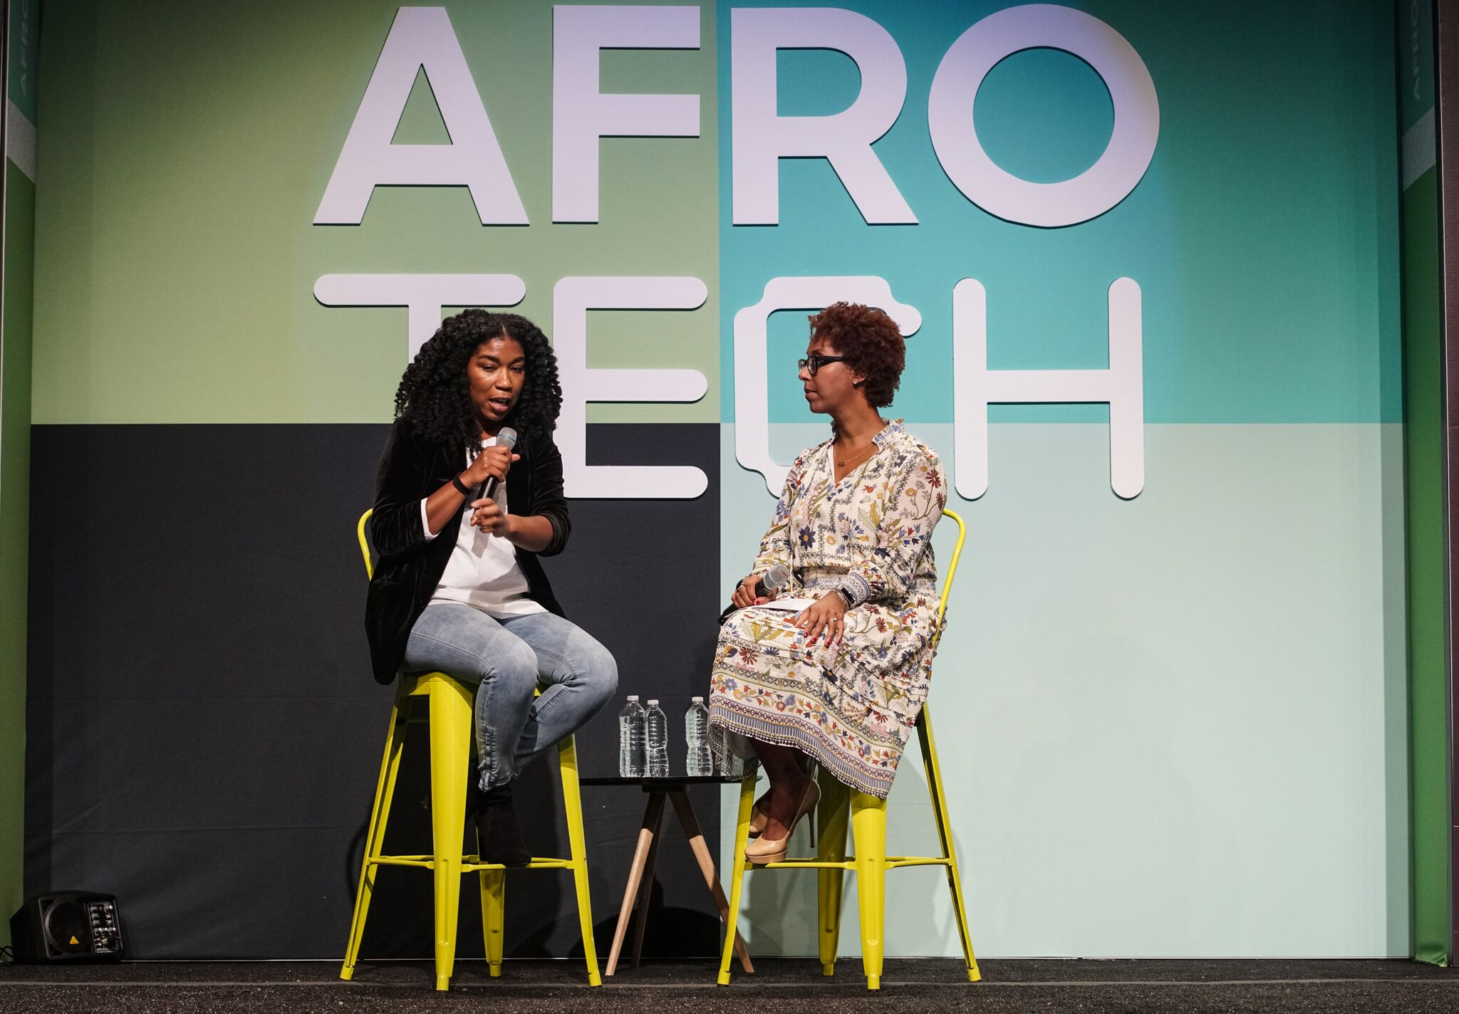

Afrotech
Conference: largest multicultural tech conference in the U.S.
Highlight black stories (https://afrotech.com/news)
Podcast: Black Tech Green Money
https://afrotech.com/

Slide 7
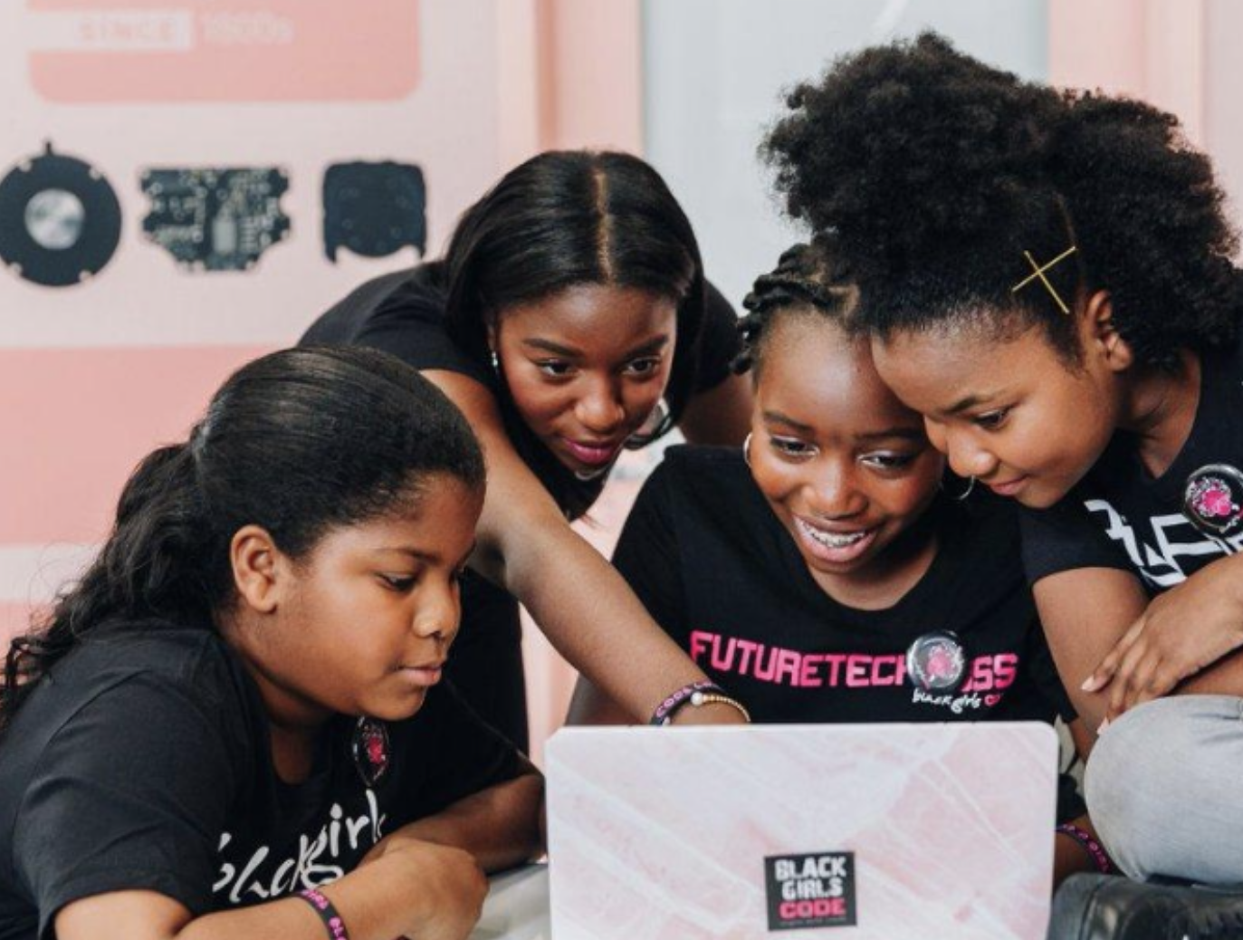
Black Girls Code
Vision: To increase the number of women of color in the digital space by empowering girls of color ages 7 to 17 to become innovators in STEM fields, leaders in their communities, and builders of their own futures through exposure to computer science and technology. To provide African-American youth with the skills to occupy some of the 1.4 million computing job openings expected to be available in the U.S. by 2020, and to train 1 million girls by 2040.
https://www.blackgirlscode.com/

Slide 8
LGBT Technology Partnership & institute
Conduct research at the intersection of LGBTQ and technology to better understand the unique needs of our community and inform those devolving products and tech policy.
The LGBT Technology Partnership: improve access, increase inclusion, ensure safety and empower entrepreneurship for LGBT communities around technology.
PowerOn: distributes technology to homeless, isolated, and disadvantaged LGBTQ+ individuals across the country.
Cool podcast with 6 episodes, I recommend if you’re interested! (https://soundcloud.com/lgbttech)
https://www.lgbttech.org/

Slide 9
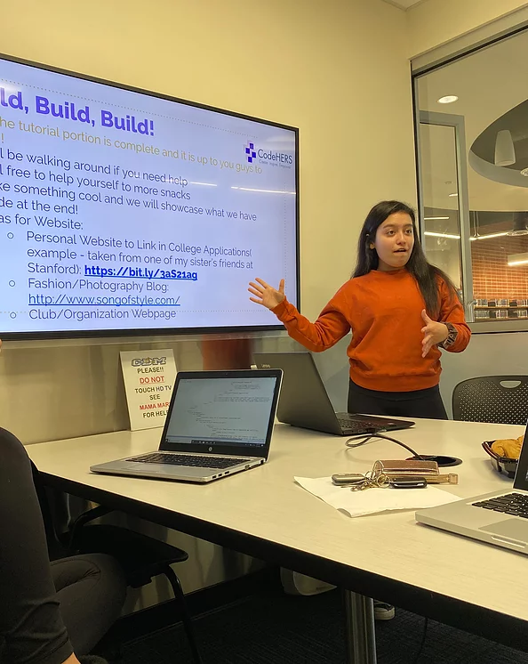
codeHERS
Local (:
Support by following their IG @gocodehers
Mission:In an era when women are increasingly prominent in medicine, law, and business, women still make up only 14% of engineers in the United States. Studies show that this is due to a number of factors including implicit biases about women in STEM and unconscious barriers in STEM education. Thus, the purpose of codeHERS is to help break the gender gap in STEM providing girls with engineering career exploration, mentorship, and technical workshops -- catalyzing change in engineering.
https://codehs.com/

Slide 10
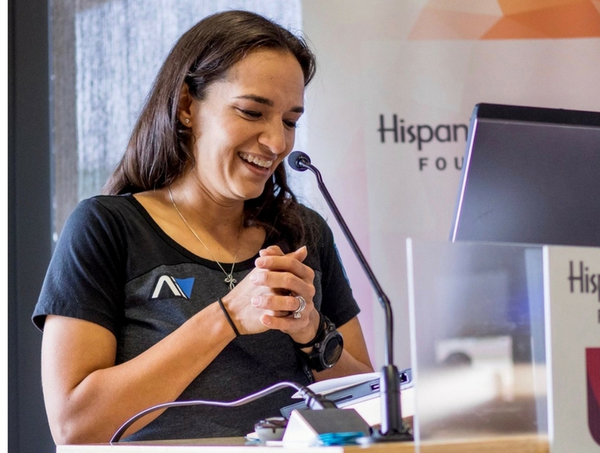
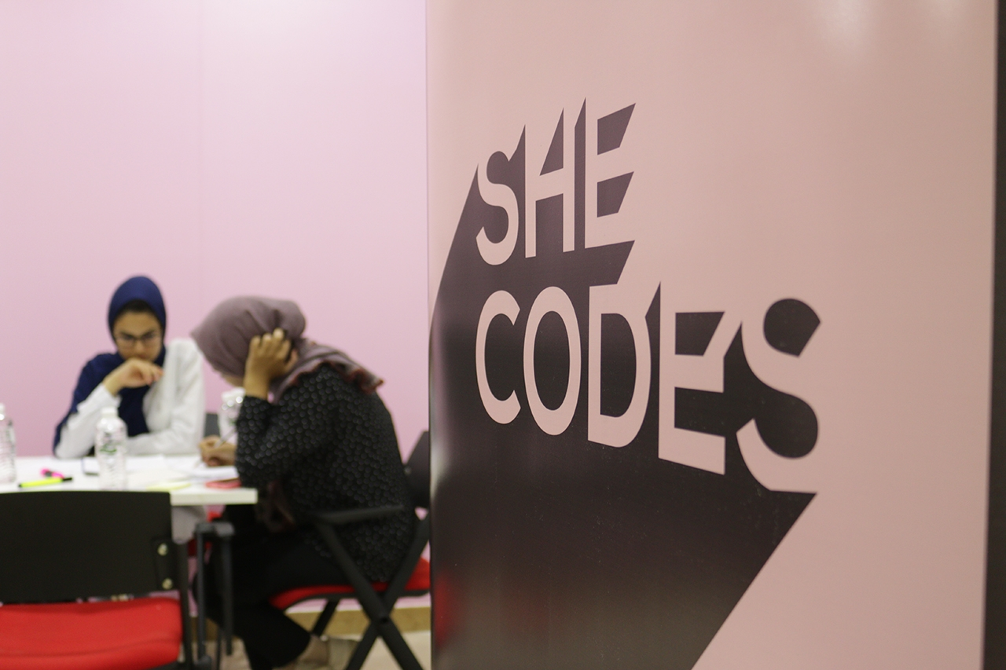
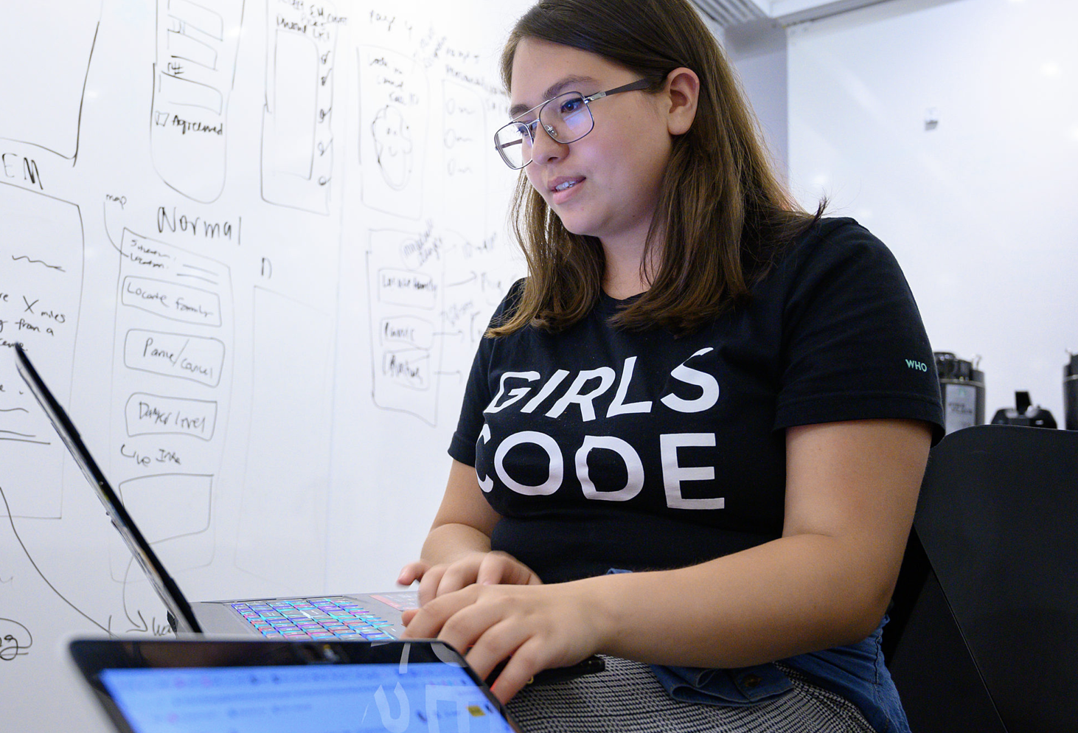

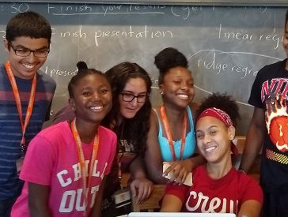
Other initiatives to look into for possible inspiration:
LOFT Coder Summit by Hispanic Heritage Foundation
She Codes
Girls Who Code
Women In Tech
AI 4 ALL

